Slide 1

Online Retail Store Consumer Insights
Empowering Business with Effective Insights
Author: Akshay Pandurang Paunikar

Slide 2
Data Cleaning and Validation
Data is cleaned properly, negative values are removed and erroneous data is treated accordingly
Ensured correct values are presented according to the column data.
Removed any data that has quantity below 1 Unit.
Unit Price should not be below $1.
Excluded United Kingdom from analysis as requested.

Slide 3
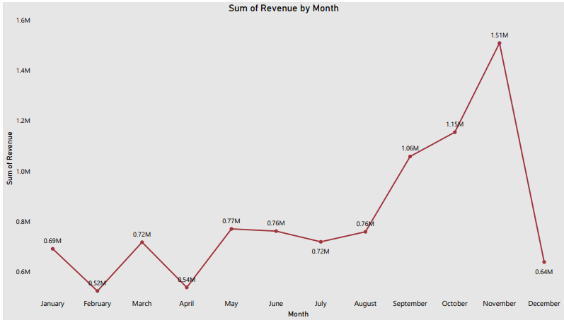
Revenue Analysis (Time Series)
Sharp increase in revenue starting from September to November.
February and April lowest revenue.

Slide 4
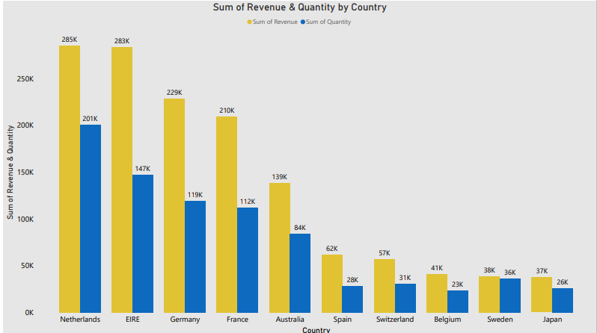
Top 10 Countries (Quantity & Revenue)
Netherlands, Ireland & Germany tops in our data for highest quantity and highest revenue.
Keeping an eye on Customers purchase patterns is key factor for business growth.

Slide 5
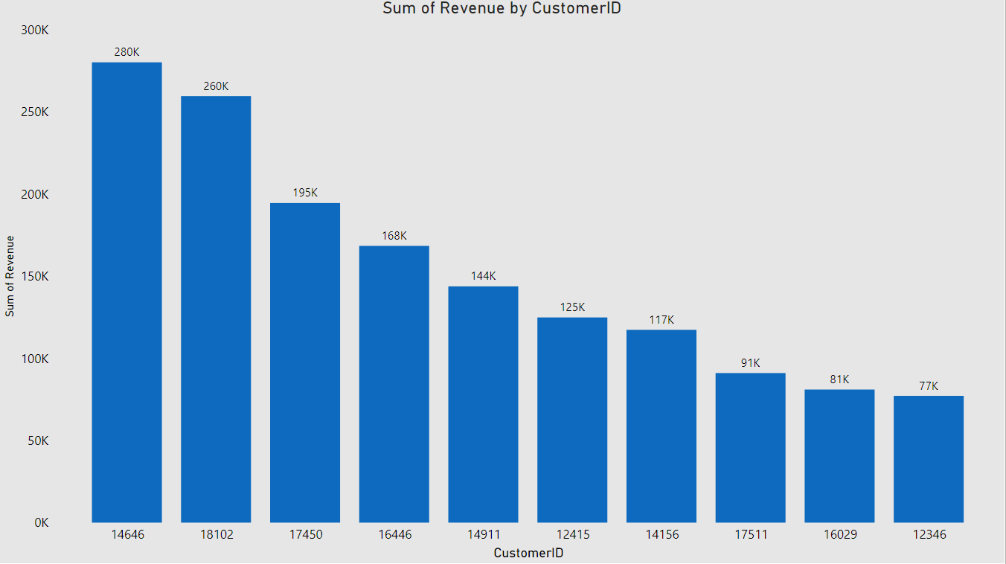
Customer Analysis
The highest revenue generating customer only purchased 17% more than the 2nd highest
The bargaining power of customers is low and the business is in a good position.

Slide 6
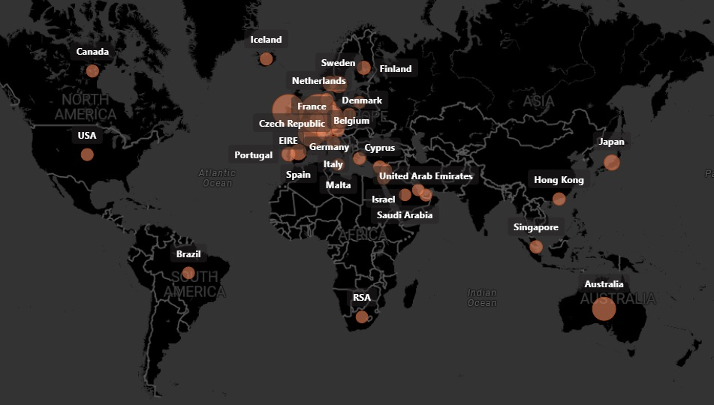
Region-wise Revenue
Netherlands, Ireland, Germany, France and Australia are generating high revenue.
Africa and Asia do not have any demand for the products, along with Russia.

Slide 7
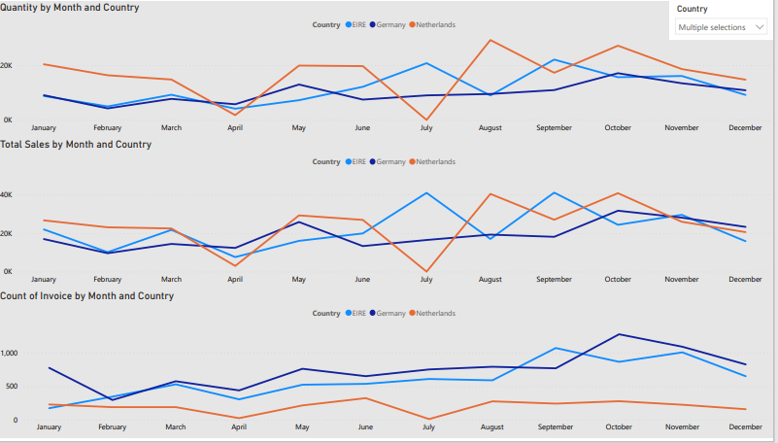
Top 3 Countries Analysis
Sharp increase and decrease in Quantity and Revenue in the month of July and August for Netherlands and Ireland.
Finding the key factor can change the business scenario significantly.

Slide 8
Conclusion
Business growth is highly affected by the seasonality.
Expanding business in regions like Russian, Asia & Africa will increase sales revenue.
European countries are generating maximum sales which includes countries like Netherlands, Ireland, Germany etc.
Need a deep understanding of the products that are sold in particular region in every season to boost our sales.

Slide 9
Thank You!!!
Questions???

